Slide 1
Official Web Portals
Flow-chart Presentation

Slide 2
Flow Chart For Multiple Web Portal
Main Official Website
www.ajscompany.com
(Content Management System With Online Payment For All Services)
AJS REAL ESTATE
realestate.ajscompany.com
AJS HOTEL
hotel.ajscompany.com
AJS LOGISTICS
logistics.ajscompany.com
AJS CONSTRUCTION
construction.ajscompany.com
AJS Real Estate Database
AJS Hotel Database
AJS Logistics Database
AJS Construction Database
Paystack Online Payment
www.paystack.com

Slide 3
Features Per Website
Main Official Website:
Home Page and other subsequent pages like about us, services, contact us page blog, etc.
Content Management System: This will enables you to manage your website’s content yourself
Our Services Page: This page will connect customer(s) to other Web Portals
Admin Backend: to manage main official website
Hotel Web Portal:
All features on Main Official Website.
Online Payment gateway to receive order/payment
Customers records.
Admin backend to monitor sales
If you want Hotel Management System to be used in-house to work with your hotel website. You can request this specially. See diagram of our Hotel Management System below;

Slide 4
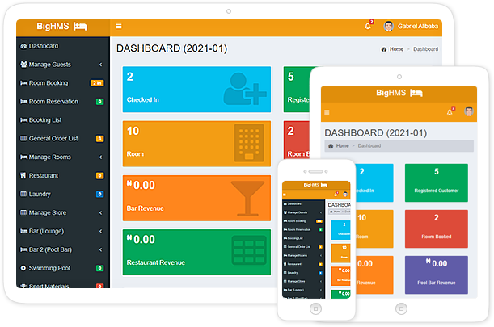


Hotel Management System (BIGHMS)
It comes with RFID Hotel Door Lock system software

Slide 5
Features Per Website
Logistics Web Portal:
All features on Main Official Website.
Online Payment gateway to receive order/payment
Customers / Drivers records.
Admin backend to monitor sales
App to track in-out of drivers. This will enable customer to know available drivers and track their parcels.
Etc.
Construction Web Portal:
All features on Main Official Website.
Online Payment gateway to receive order/payment
Customers records.
Admin backend to monitor sales
Manage Past & Ongoing Projects
Etc.

Slide 6
Our Past Projects
Realsgroup.com (Canada)
josepharchers.com (Canada)
fayochem.com (Dubai)
vilutonenergy.com (Nigeria)
Vilutonmanager.com (Official Portal For distribution of AGO & PMS)
smartbuycars.us (USA)
proxonservices.com (Canada)
proxford.com (Canada)
And lots more

Slide 7
THANK YOU

